Slide 1
Program Soal-Soal UTS
Firnanda Pristiana Nurmaida - 1122800004

Slide 2
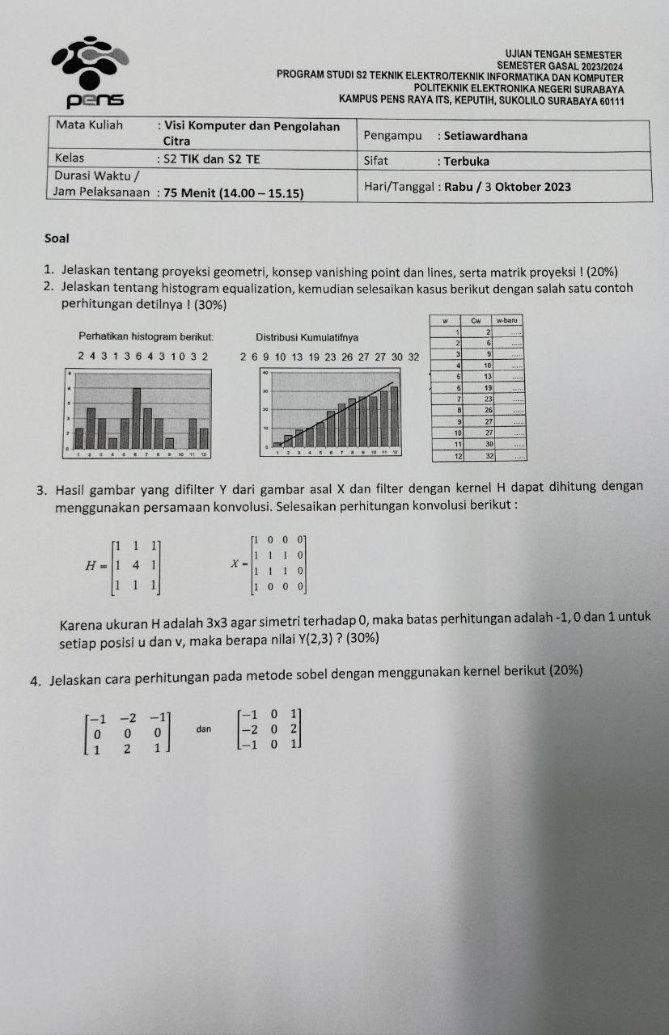
No 2

Slide 3
Penjelasan Program
#include<stdio.h>
void main(){
int h[1000];
int c[1000];
int wbaru[1000];
int cc = 0;
h[1] = 2;
h[2] = 4;
h[3] = 3;
h[4] = 1;
h[5] = 3;
h[6] = 6;
h[7] = 4;
h[8] = 3;
h[9] = 1;
h[10] = 0;
h[11] = 3;
h[12] = 2;
for (int i = 1; i <=12; i++)
{
cc = cc + h[i];
c[i] = cc;
}
for (int i = 1; i <=12; i++)
{
wbaru[i] = (c[i]*12)/32;
}
printf("w | Cw | w-baru\n");
for (int i = 1; i <=12; i++)
{
printf("%d | %d | %d\n", h[i], c[i], wbaru[i]);
}
}
Inisialisasi nilai w awal
Menghitung nilai w kumulatif (Cw)
Menghitung nilai w baru
Menampilkan nilai w awal, w kumulatif, dan w baru

Slide 4
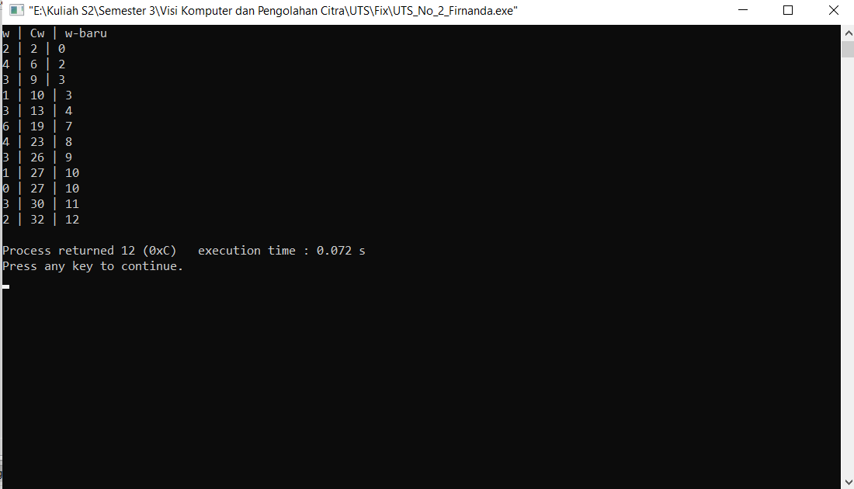
Output Program

Slide 5
No 3

Slide 6
Penjelasan Program
#include<stdio.h>
void main(){
int X[100][100];
int Y, x, y;
int Pawal, Pakhir, Qawal, Qakhir;
//Matriks gambar asal adalah sebagai berikut:
X[1][1] = 1; X[1][2] = 0; X[1][3] = 0; X[1][4] = 0;
X[2][1] = 1; X[2][2] = 1; X[2][3] = 1; X[2][4] = 0;
X[3][1] = 1; X[3][2] = 1; X[3][3] = 1; X[3][4] = 0;
X[4][1] = 1; X[4][2] = 0; X[4][3] = 0; X[4][4] = 0;
for(int z = 1; z<=10; z++)
{
X[10][z] = 0;
X[z][10] = 0;
}
printf("Mencari hasil konvolusi pada:\n");
printf("Baris : ");
scanf("%d", &x);
printf("Kolom : ");
scanf("%d", &y);
Pawal = x-1; Pakhir = x+1;
Qawal = y-1; Qakhir = y+1;
if(Pawal<1) Pawal = 10; if(Pakhir>4) Pakhir = 10;
if(Qawal<1) Qawal = 10; if(Qakhir>4)Qakhir = 10;
//printf("%d, %d, %d, %d", Pawal, Pakhir, Qawal, Qakhir);
Y = X[Pawal][Qawal]+X[Pawal][y]+X[Pawal][Qakhir]+X[x][Qawal]+4*X[x][y]
+X[x][Qakhir]+X[Pakhir][Qawal]+X[Pakhir][y]+X[Pakhir][Qakhir];
printf("\nNilai Y[%d][%d] adalah %d\n\n", x,y,Y);
}
Matriks gambar asal
Program agar elemen di luar matriks bernilai 0
Hasil konvolusi dengan filter

Slide 7
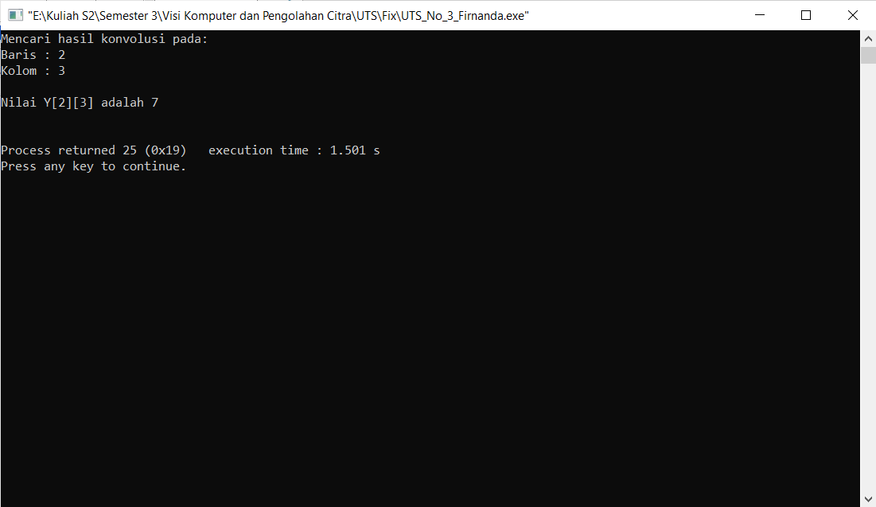
Output Program

Slide 8
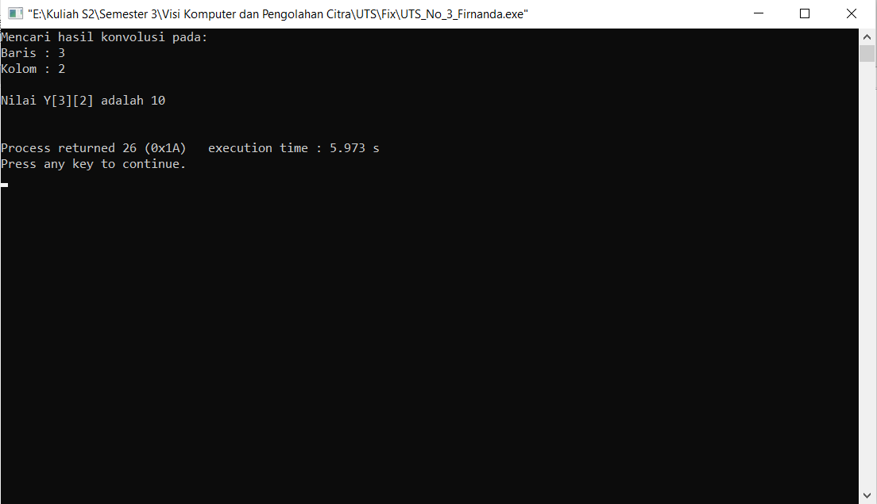

Slide 9
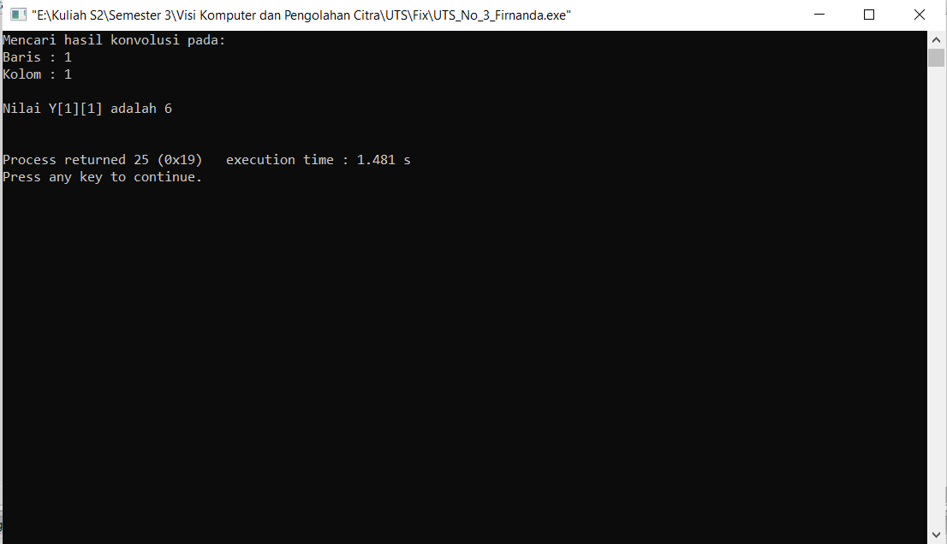

Slide 10
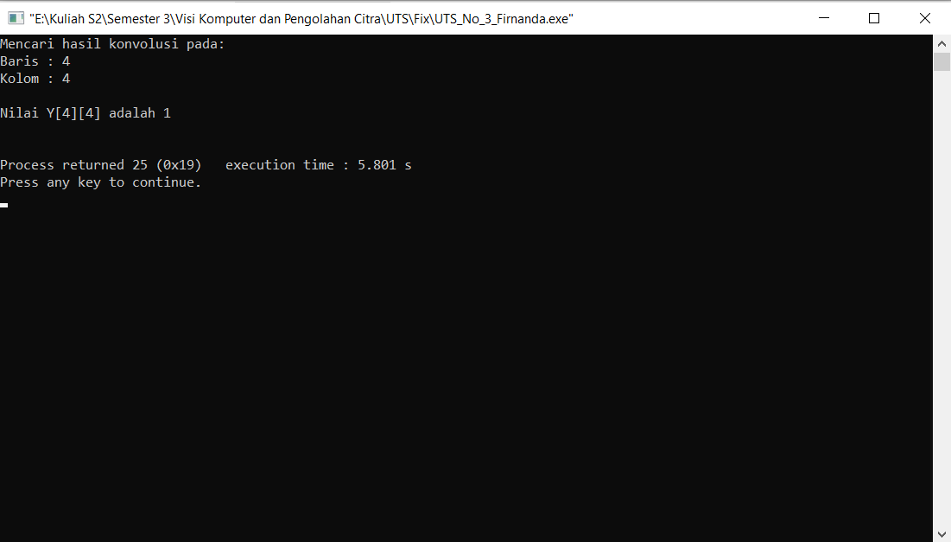

Slide 11
No 4

Slide 12
Penjelasan Program
#include<stdio.h>
void main(){
int X[100][100];
int Pawal, Pakhir, Qawal, Qakhir;
int x, y;
int Yx, Yy, Ytot;
//Misalnya matriks gambar asal adalah sebagai berikut:
X[1][1] = 1; X[1][2] = 0; X[1][3] = 0; X[1][4] = 0;
X[2][1] = 1; X[2][2] = 1; X[2][3] = 1; X[2][4] = 0;
X[3][1] = 1; X[3][2] = 1; X[3][3] = 1; X[3][4] = 0;
X[4][1] = 1; X[4][2] = 0; X[4][3] = 0; X[4][4] = 0;
for(int z = 1; z<=10; z++)
{
X[10][z] = 0;
X[z][10] = 0;
}
printf("Mencari hasil konvolusi dengan metode sobel pada:\n");
printf("Baris : ");
scanf("%d", &x);
printf("Kolom : ");
scanf("%d", &y);
Pawal = x-1;
Pakhir = x+1;
Qawal = y-1;
Qakhir = y+1;
if(Pawal<1) Pawal = 10;
if(Pakhir>4) Pakhir = 10;
if(Qawal<1) Qawal = 10;
if(Qakhir>4)Qakhir = 10;
//printf("%d, %d, %d, %d", Pawal, Pakhir, Qawal, Qakhir);
Yx = -X[Pawal][Qawal]-2*X[Pawal][y]-X[Pawal][Qakhir]+X[Pakhir][Qawal]+2*X[Pakhir][y]+X[Pakhir][Qakhir];
Yy = -X[Pawal][Qawal]+X[Pawal][Qakhir]-2*X[x][Qawal]+2*X[x][Qakhir]-X[Pakhir][Qawal]+X[Pakhir][Qakhir];
Ytot = Yx+Yy;
printf("\nNilai Y[%d][%d] adalah %d\n\n", x,y,Ytot);
}
Matriks gambar asal
Program agar elemen di luar matriks bernilai 0
Hasil konvolusi

Slide 13
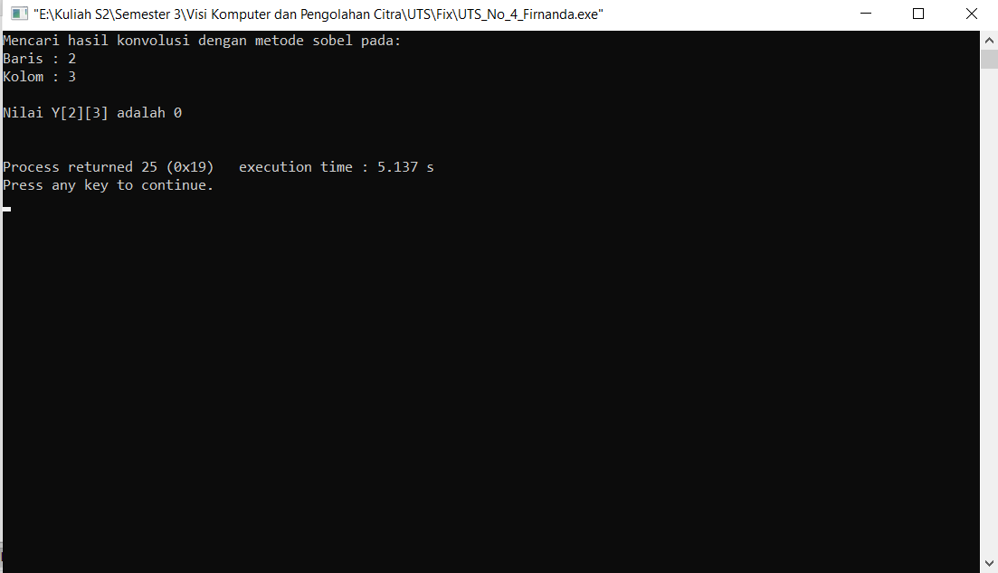
Output Program

Slide 14
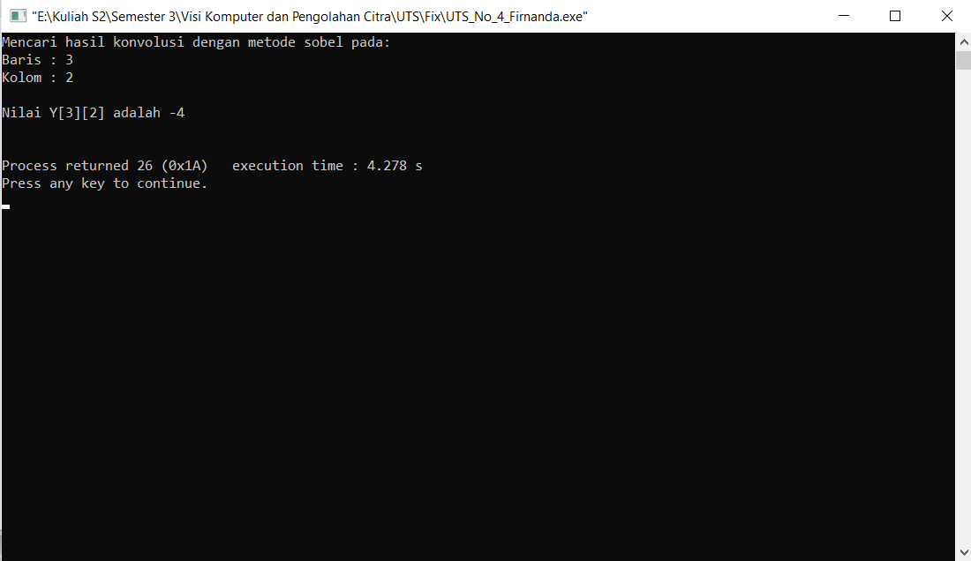

Slide 15


Slide 16


Slide 17
Terimakasih

